Slide 1
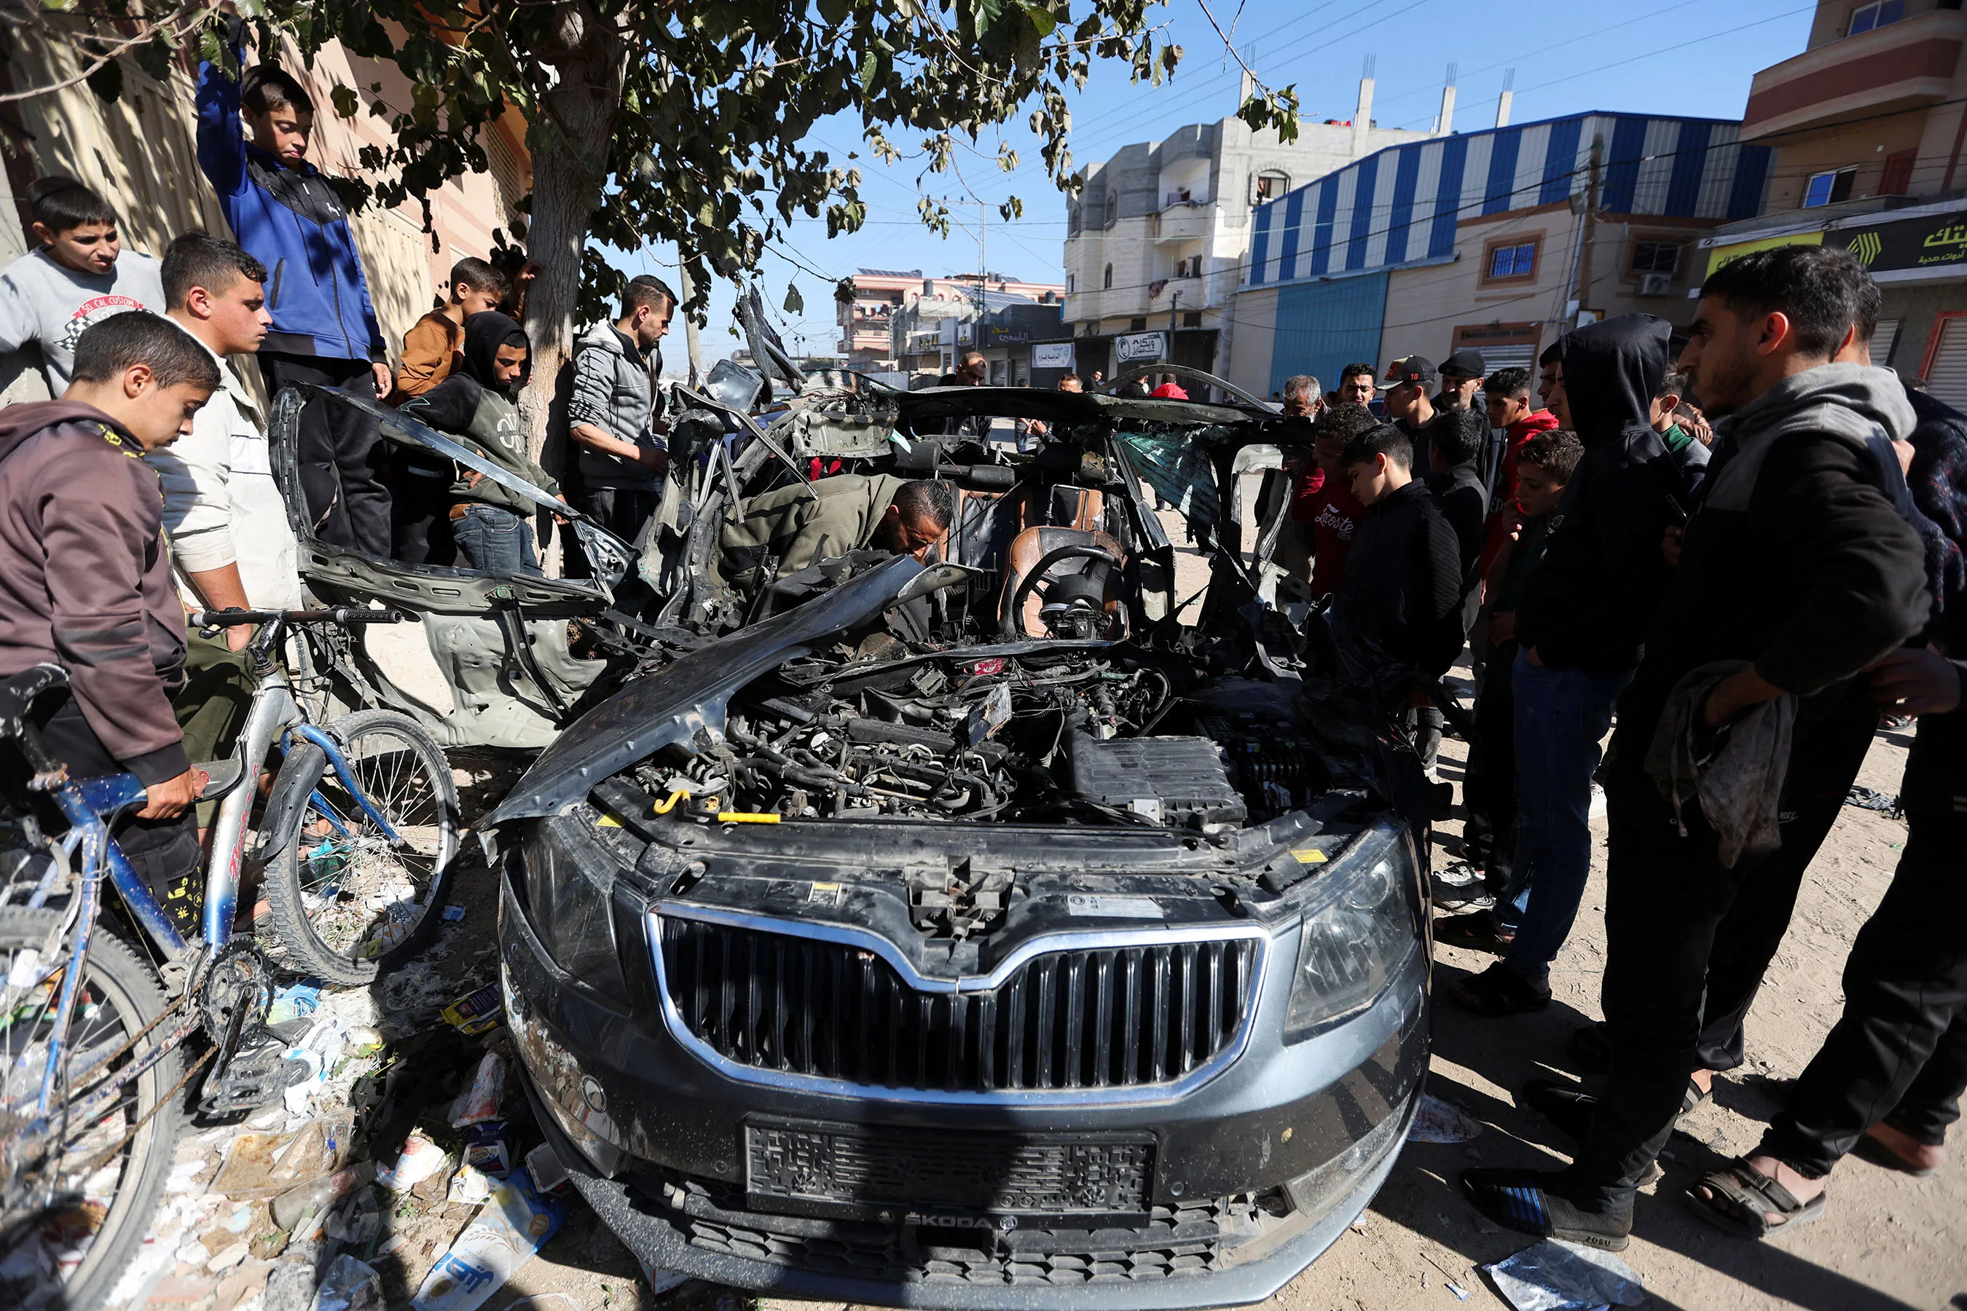
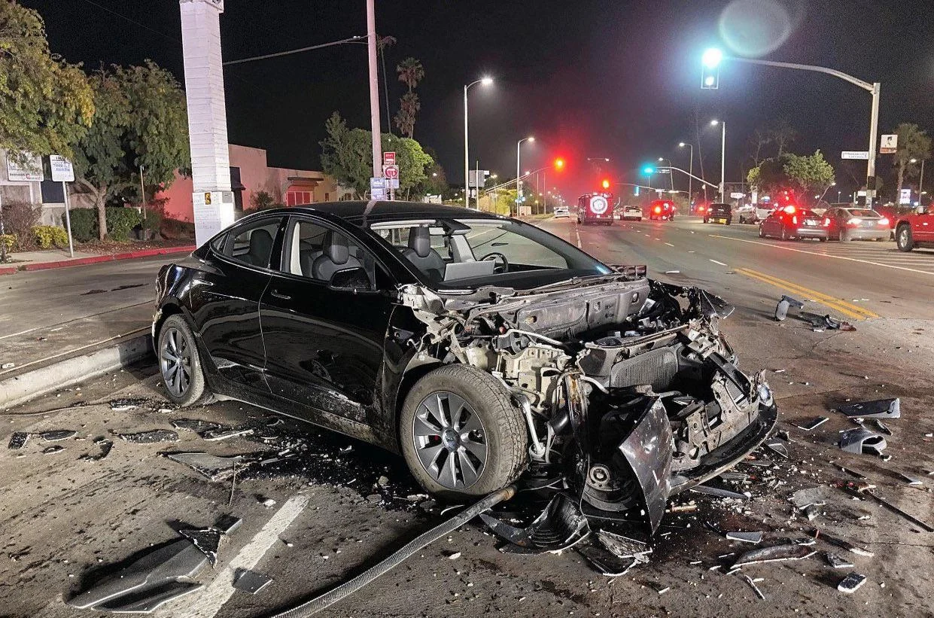
Which is Real?

Slide 2
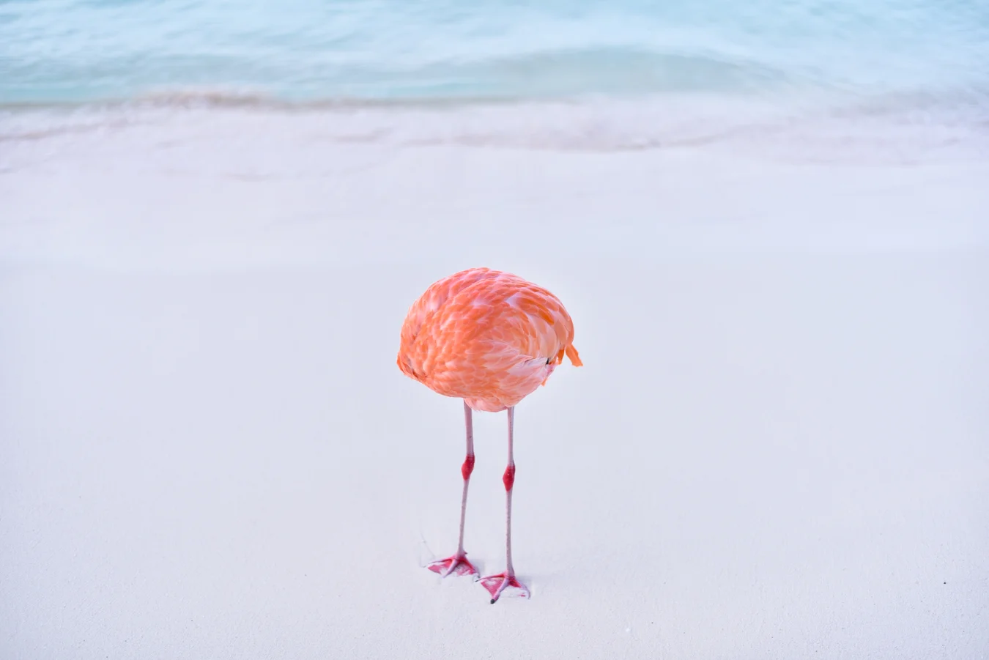

Which is Real?

Slide 3
Intentionally Left Blank
Notes:
This slide is left blank and shall be hidden. When opening the slide deck this slide will help prevent participants from seeing the results

Slide 4
Intentionally Left Blank
Notes:
This slide is left blank and shall be hidden. When opening the slide deck this slide will help prevent participants from seeing the results

Slide 5
Intentionally Left Blank
Notes:
This slide is left blank and shall be hidden. When opening the slide deck this slide will help prevent participants from seeing the results

Slide 6
Intentionally Left Blank
Notes:
This slide is left blank and shall be hidden. When opening the slide deck this slide will help prevent participants from seeing the results

Slide 7
Intentionally Left Blank
Notes:
This slide is left blank and shall be hidden. When opening the slide deck this slide will help prevent participants from seeing the results

Slide 9
Identifying Synthetic Content
Notes:
Start by creating a slide master that is in English. As needed duplicate and translate slides into target language. Color English slides in Yellow and target language slides in white. The example below uses Spanish as a theoretical target language.

Slide 10
Lesson Objectives
Identify AI-generated content effectively using specific detection techniques for images, text, and audio.
Lesson is approximately 120 minutes.
Detecting Synthetic with the human eye alone is limited.
References:
Media Lab at MIT on Detecting Fakes
Detect Fakes with Kellogg's online tool
CISA Contextualizing Deepfake Threats to Organizations
DARPA: Deepfake Defense Tech Ready for Commercialization, Transition
Notes:
"AI Generated Content is becoming increasingly sophisticated and harder to detect. There will be many situations where it is not possible to determine if content is AI-generated or not. More advanced technical tools and techniques are required to detect AI-generated content."

Slide 11
Terms Used
Synthetic Content: All-encompassing term for different sorts of automatic and artificial media productions, including video, audio and text manipulation. Synthetic media are commonly based on artificially intelligent software.
Deep Fakes: defined as manipulated or synthetic audio or visual media that seem authentic, and which feature people that appear to say or do something they have never said or done, produced using artificial intelligence techniques, including machine learning and deep learning.
https://www.europarl.europa.eu/RegData/etudes/STUD/2021/690039/EPRS_STU(2021)690039_EN.pdf
Notes:
1. https://www.europarl.europa.eu/RegData/etudes/STUD/2021/690039/EPRS_STU(2021)690039_EN.pdf

Slide 12
Memorize Synthetic Check: Human Image
Context of the scene
Hands and limbs of people
Face and facial features
Clothes and items
Notes:
Give students time to memorize this on their own. The focus is on memorization not yet on the explaining of each of these.

Slide 13
Memorize Structure Image Check
Context of the scene
Structural Consistency
Material Texture
Lighting and Shadows
Perspective and Geometry
Repetition in Detail
Missing Elements
Nonsensical Object Placement
Disrupted Continuity
Anomalies in Common Patterns
Notes:
Give students time to memorize this on their own. The focus is on memorization not yet on the explaining of each of these.

Slide 14
Synthetic Check: Human Image
Context of the scene
Hands and limbs of people
Face and facial features
Clothes and items

Slide 15
Structure Image: Check On Learning
Context of the scene
Structural Consistency
Material Texture
Lighting and Shadows
Perspective and Geometry
Repeating or Missing Elements
Nonsensical Object Placement
Anomalies in Common Patterns

Slide 16
Answers Structure Image Check
Context of the scene
Structural Consistency
Material Texture
Lighting and Shadows
Perspective and Geometry
Repeating or Missing Elements
Nonsensical Object Placement
Anomalies in Common Patterns

Slide 17
Answers Synthetic Check: Human Image
Context of the scene
Hands and limbs of people
Face and facial features
Clothes and items

Slide 18
Define Synthetic Check: Human Image
Context of the scene
Hands and limbs of people
Face and facial features
Clothes and items

Slide 19
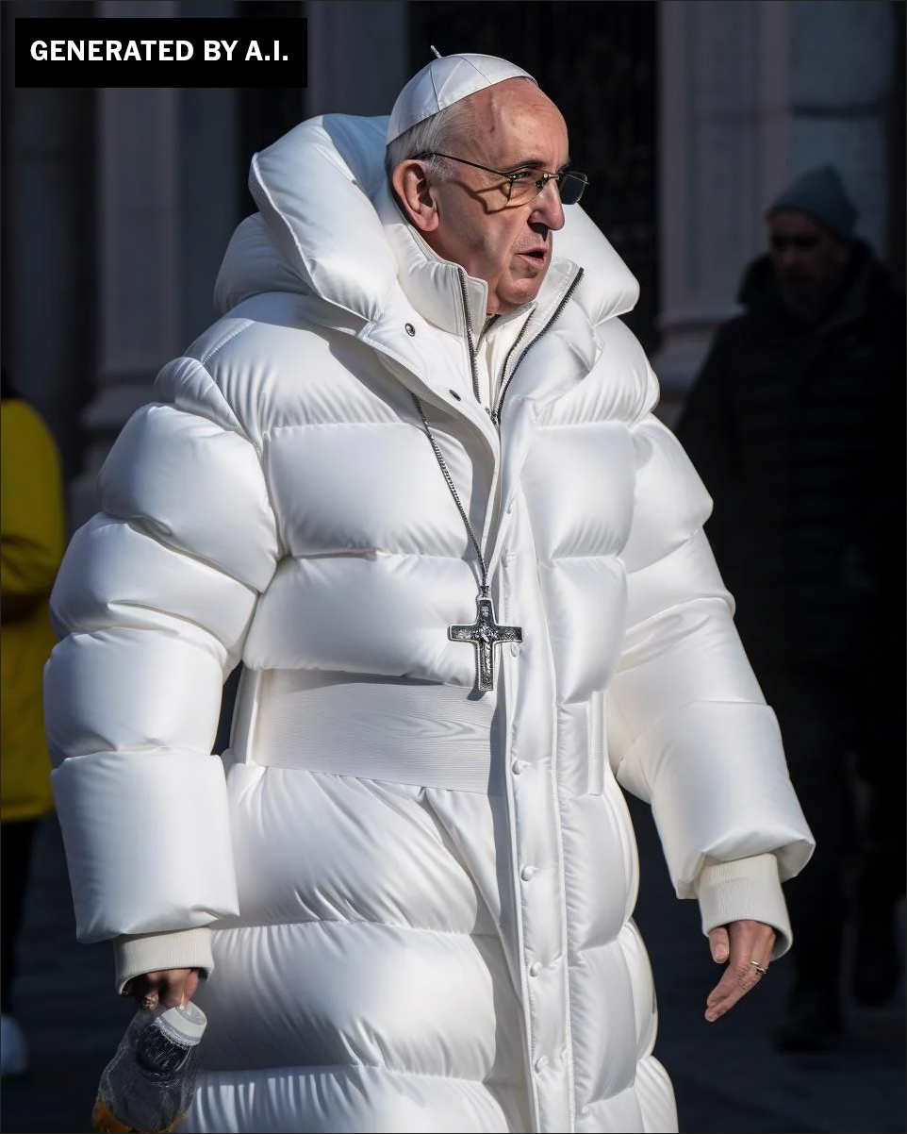
Human Images
What are the steps ?

Slide 20
Human Images: Context
Logic and Context of the Scene

Slide 21
Human Images: Hands and Limbs
Pay Attention to the Hands and Fingers

Slide 22
Human Images: Face
Pay Attention to the Face
Pay attention to the cheeks and forehead
Pay attention to the eyes and eyebrows
Pay attention to the glasses
Pay attention to facial hair
Pay attention to facial moles

Slide 23
Human Images: Clothing
Pay attention to the clothes
Warped Items
Missing and Extra items
Perspective and Geometry
Repetition in Detail
Material Texture

Slide 24
Human Image Check: Check On Learning
Context of the scene
Hands and limbs of people
Face and facial features
Clothes and items
Notes:
Order and definitions

Slide 25
Human Image Check
Context of the scene
Hands and limbs of people
Face and facial features
Clothes and items

Slide 26
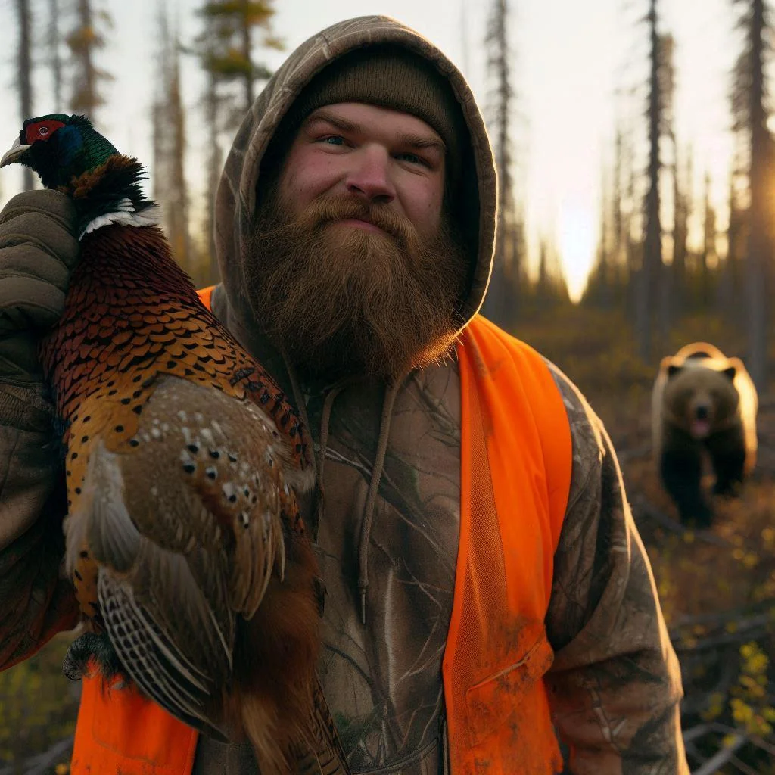
Human Images: Check On Learning
What do you notice?
Notes:
The scene, consider the bear sneaking up on him (bears can be noisy) See the extra drawstring on the hoody See the texture of the Visibility vest which is very different than outdoor gear

Slide 27
Human Images: Check On Learning
What do you notice?
Notes:
The scene, consider the bear sneaking up on him (bears can be noisy) See the extra drawstring on the hoody See the texture of the Visibility vest which is very different than outdoor gear

Slide 28
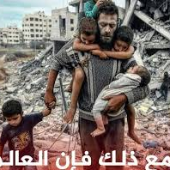
Human Images: Check On Learning
What do you notice?
Notes:
Notice the hands
Notice how long the boys shoulder would need to be
Notice the toes
Notice the dark figure in the background

Slide 29
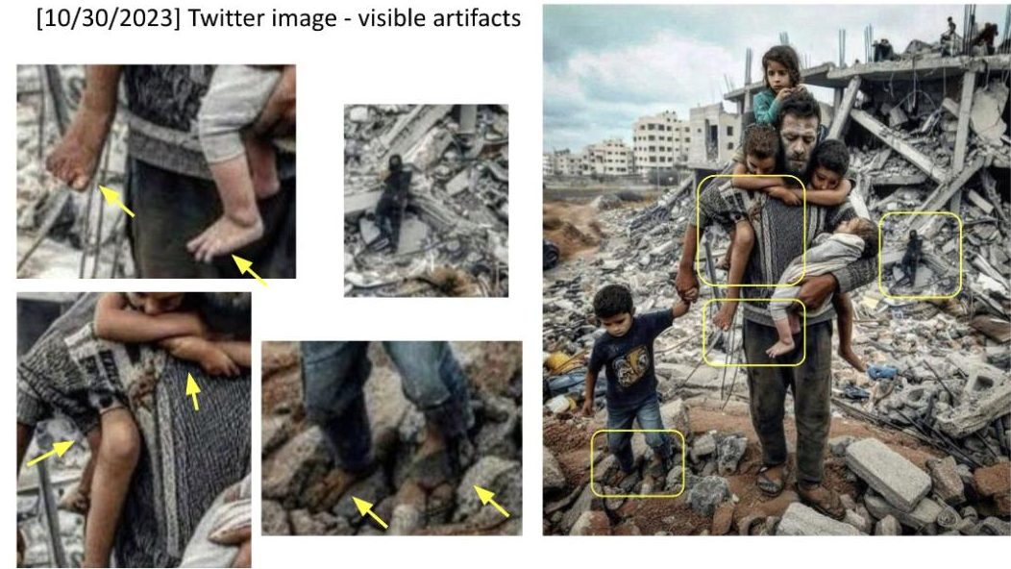

Slide 30
Define Structure Image Check
Context of the scene
Structural Consistency
Material Texture
Lighting and Shadows
Perspective and Geometry
Repeating or Missing Elements
Nonsensical Object Placement
Anomalies in Common Patterns

Slide 31
Structure Image
What do you notice?
Notes:
the lanes are nonsensical
The green light on top
The Light posts seem odd
The signs and language seem nonsensical
Some of the cars have no tires
This is supposed to be a tesla but the wheels are off
The windshield seems to disappear in some areas.

Slide 32
Structure Image
Structural Consistency
Perspective and Geometry
Repetition in Detail
Nonsensical Object Placement
Anomalies in Common Patterns

Slide 33
Structure Image
Structural Consistency
Perspective and Geometry
Repetition in Detail
Nonsensical Object Placement
Anomalies in Common Patterns

Slide 34
Structure Image
Structural Consistency

Slide 35
Structure Image: Check On Learning
Context of the scene
Structural Consistency
Material Texture
Lighting and Shadows
Perspective and Geometry
Repeating or Missing Elements
Nonsensical Object Placement
Anomalies in Common Patterns

Slide 36
Structure Image Check
Context of the scene
Structural Consistency
Material Texture
Lighting and Shadows
Perspective and Geometry
Repeating or Missing Elements
Nonsensical Object Placement
Anomalies in Common Patterns

Slide 37
Synthetic Video Check: Practical Exercise
Context of the scene
Structural Consistency
Material Texture
Develop your Techniques…
Search online for possible deepfake videos that have been in the news
Analyze the video
Determine your own TTP for detecting synthetic videos
Present TTPs

Slide 38

Why Does It Matter To You?
Notes:
Show this video and story if students are having trouble understanding the impact. In China, AI transformed Ukrainian YouTuber into a Russian - https://www.reuters.com/technology/artificial-intelligence/china-ai-transformed-ukrainian-youtuber-into-russian-2024-06-21/; https://www.threads.net/@reuters/post/C8di0dli_iQ/?xmt=AQGzv6X0VtSp4e0P2Ejo6X-v0Zwm5I4Th7WRWGlMR97rWQ
### References
1. Media Lab at MIT on Detecting Fakes - https://www.media.mit.edu/projects/detect-fakes/overview/
2. Detect Fakes with Kellogg's online tool - https://detectfakes.kellogg.northwestern.edu/
3. CISA Contextualizing Deepfake Threats to Organizations - https://media.defense.gov/2023/Sep/12/2003298925/-1/-1/0/CSI-DEEPFAKE-THREATS.PDF
4. DARPA: Deepfake Defense Tech Ready for Commercialization, Transition - https://www.darpa.mil/news-events/2024-03-14#:~:text=Through%20the%20Semantic%20Forensics%20
5. Scribbr AI Detector - https://www.scribbr.com/ai-detector/
6. Real Bird Image Wins AI Contest - https://www.scientificamerican.com/article/how-this-real-image-won-an-ai-photo-competition/ (Image3-Real-Bird.webp)
7. Facebook Post with AI-Generated Image of Aligators - https://www.facebook.com/story.php?story_fbid=10105216423848582&id=199109935&mibextid=NoJtEM&rdid=3RMz451RwYXWUi4R (Image1-AI-Aligators.jpeg)
8. Reddit Post Believe it or not this image is AI - https://www.reddit.com/r/ChatGPT/comments/1c8u924/believe_it_or_not_this_image_is_ai/ (Image2-AI-Car.webp)
9. Journalist's Car - https://cpj.org/2023/11/photos-israel-hamas-war-takes-unprecedented-toll-on-journalists/ (Image4-Real-Car.jpg)
10. Image of Man Hunting - https://www.reddit.com/r/aiArt/comments/1dkn336/most_realistic_image_ive_prompted/ (Image5-Real-Hunting_Bear.webp)
11. How to Spot a Deepfake - https://time.com/6266606/how-to-spot-deepfake-pope/ (Image6-AI-Pope.png)
12. X Post about Mob attacking Journalist - https://x.com/AbujomaaGaza/status/1798366219546071081 (Image7-Real-Mob_Journalist.jpg)
13. Man Carrying Kids out of Gaza Fact Check - https://factcheck.afp.com/doc.afp.com.33ZJ8WU (Image8-AI-Man_Carrying_Kids.jpg) (Image8-AI-Man_Carrying_Kids.jpeg, Image9-AI-FACTHCHECK-Man_Carrying_Kids.jpeg)
14. Reddit community focused on AI Art - https://www.reddit.com/r/aiArt/
15. In China, AI transformed Ukrainian YouTuber into a Russian - https://www.reuters.com/technology/artificial-intelligence/china-ai-transformed-ukrainian-youtuber-into-russian-2024-06-21/; https://www.threads.net/@reuters/post/C8di0dli_iQ/?xmt=AQGzv6X0VtSp4e0P2Ejo6X-v0Zwm5I4Th7WRWGlMR97rWQ

Slide 39
References
1. Media Lab at MIT on Detecting Fakes - https://www.media.mit.edu/projects/detect-fakes/overview/
2. Detect Fakes with Kellogg's online tool - https://detectfakes.kellogg.northwestern.edu/
3. CISA Contextualizing Deepfake Threats to Organizations - https://media.defense.gov/2023/Sep/12/2003298925/-1/-1/0/CSI-DEEPFAKE-THREATS.PDF
4. DARPA: Deepfake Defense Tech Ready for Commercialization, Transition - https://www.darpa.mil/news-events/2024-03-14#:~:text=Through%20the%20Semantic%20Forensics%20
Notes:
### References
1. Media Lab at MIT on Detecting Fakes - https://www.media.mit.edu/projects/detect-fakes/overview/
2. Detect Fakes with Kellogg's online tool - https://detectfakes.kellogg.northwestern.edu/
3. CISA Contextualizing Deepfake Threats to Organizations - https://media.defense.gov/2023/Sep/12/2003298925/-1/-1/0/CSI-DEEPFAKE-THREATS.PDF
4. DARPA: Deepfake Defense Tech Ready for Commercialization, Transition - https://www.darpa.mil/news-events/2024-03-14#:~:text=Through%20the%20Semantic%20Forensics%20
5. Scribbr AI Detector - https://www.scribbr.com/ai-detector/
6. Real Bird Image Wins AI Contest - https://www.scientificamerican.com/article/how-this-real-image-won-an-ai-photo-competition/ (Image3-Real-Bird.webp)
7. Facebook Post with AI-Generated Image of Aligators - https://www.facebook.com/story.php?story_fbid=10105216423848582&id=199109935&mibextid=NoJtEM&rdid=3RMz451RwYXWUi4R (Image1-AI-Aligators.jpeg)
8. Reddit Post Believe it or not this image is AI - https://www.reddit.com/r/ChatGPT/comments/1c8u924/believe_it_or_not_this_image_is_ai/ (Image2-AI-Car.webp)
9. Journalist's Car - https://cpj.org/2023/11/photos-israel-hamas-war-takes-unprecedented-toll-on-journalists/ (Image4-Real-Car.jpg)
10. Image of Man Hunting - https://www.reddit.com/r/aiArt/comments/1dkn336/most_realistic_image_ive_prompted/ (Image5-Real-Hunting_Bear.webp)
11. How to Spot a Deepfake - https://time.com/6266606/how-to-spot-deepfake-pope/ (Image6-AI-Pope.png)
12. X Post about Mob attacking Journalist - https://x.com/AbujomaaGaza/status/1798366219546071081 (Image7-Real-Mob_Journalist.jpg)
13. Man Carrying Kids out of Gaza Fact Check - https://factcheck.afp.com/doc.afp.com.33ZJ8WU (Image8-AI-Man_Carrying_Kids.jpg) (Image8-AI-Man_Carrying_Kids.jpeg, Image9-AI-FACTHCHECK-Man_Carrying_Kids.jpeg)
14. Reddit community focused on AI Art - https://www.reddit.com/r/aiArt/
15. In China, AI transformed Ukrainian YouTuber into a Russian - https://www.reuters.com/technology/artificial-intelligence/china-ai-transformed-ukrainian-youtuber-into-russian-2024-06-21/; https://www.threads.net/@reuters/post/C8di0dli_iQ/?xmt=AQGzv6X0VtSp4e0P2Ejo6X-v0Zwm5I4Th7WRWGlMR97rWQ
16. EU Report on Deep Fakes - https://www.europarl.europa.eu/RegData/etudes/STUD/2021/690039/EPRS_STU(2021)690039_EN.pdf

Slide 40

TAKE A BREAK
Return By: XX:XX

